Slide 1
Predix Visualization

Slide 2
Introduction
Best Practices
Widgets help with:
IIDS Changes
IIDS API changes often. Abstraction layer helps reduce changes for Predix applications
Easy UI design in Workbench
Drag and drop, it’s that simple
Creation of custom widgets
Programmatic
Declarative (today’s subject)

Slide 3
Goals and Objectives
Best Practices
After completing this course, you will be able to:
Create your own widget for workbench
Customize existing widgets

Slide 4
Anatomy of a Widget

Slide 5
File Structure of Declarative Widgets
<Predix V>/conf/components/custom-widget/
custom-widget.schema.json
custom-widget.tmpl
custom-widget.api.js
custom-widget.png

Slide 6
Definition Schema
{
"name": "Google Map",
"icon": "gmap-icon.png",
"overlay": "gmap-overlay.png",
"type": "Map",
"category": "Map",
"description": "A map widget with options to overlay weather, traffic and markers",
"templates": [
"gmap.tmpl"
],
"properties": {
"address": {
"type": "textarea",
"default": "2623 Camino Ramon, San Ramon, CA94582",
"required": true
},
"traffic": {
"type": "enum",
"default": "",
"enum": [
"No",
"Yes"
],
"required": true
}
}
}
Notes:
This is from the Custom Widget technote on the predix website. Sample widget schema definition

Slide 7
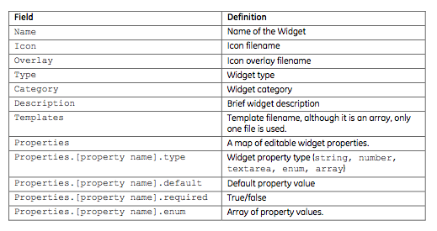
Definition Schema

Slide 8
.tmpl HTML Template
Raw HTML file to be injected into the code
Example button from IIDS
<button rel="stateful" data-loading-text="loading..." class="btn">Button</button>

Slide 9
.api.js JavaScript file
RequireJS module, implement and return a widget base class
define([ "jquery", "common/js/ge/views/iids-widget”], function($, IIDSWidget) {
return IIDSWidget.extend({
beforeRender : function(beforeRenderOptions) {
this._super.apply(this, arguments);
return this;
}
render : function(renderOptions) {
this._super.apply(this, arguments);
return this;
}
afterRender(afterRenderOptions) {
this._super.apply(this, arguments);
return this;
}
show(showOptions) {
this._super.apply(this, arguments);
return this;
}
});
});

Slide 10
Icon file
.png thumbnail file that will be displayed in the widget panel

Slide 11
Lesson1:Create a Custom Widget

Slide 12
Lesson 1
Create a custom chart widget
Add this widget to workbench
Use the widget in an application

Slide 13
Extending a Widget

Slide 14
Base Widgets
/public/gia/common/js/ge/views/
base-widget.js
iids-widget.js

Slide 15
Widget Lifecycle Methods
Overrideable Lifecycle Methods exposed
beforeRender(beforeRenderOptions)
render(renderOptions)
afterRender(afterRenderOptions)
show(showOptions)
JS hookpoint generated in /public/javascripts/view_<viewname>.js

Slide 16
Lesson 2: Widget extensions

Slide 17
Widget Extensions
Overwrite an existing widget method and append your own functionality
In this Lesson: IIDS right click context menu

Slide 18
Widget Extensions
Through this API, widgets are completely customizable

